Slide 1

Title: How Southeastern Railway Can Utilize Artificial Intelligence
Subtitle: Leveraging AI for Enhanced Railway Operations
By
Paul Akinpelu
MSc in Artificial Intelligence (In-View)

Slide 2
Introduction to AI in Railways
What is Artificial Intelligence (AI)?
Types of AI
Importance of AI in the Railway Industry and Specific Benefits for Southeastern Railway
Notes:
Title: Introduction to AI in Railways
Content:
What is Artificial Intelligence (AI)?
Definition: AI refers to the simulation of human intelligence processes by machines, particularly computer systems. These processes include learning (acquisition of information and rules for using the information), reasoning (using the rules to reach approximate or definite conclusions), and self-correction.
Types of AI:
Narrow AI: Specialized in performing a single task (e.g., recommendation systems).
General AI: Hypothetical AI that would outperform humans in almost every cognitive task.
Importance of AI in the Railway Industry:
Operational Efficiency: AI can automate various operational processes, reducing human error and improving efficiency.
Predictive Maintenance: AI algorithms can predict when and where maintenance is required, preventing delays and improving safety.
Enhanced Customer Experience: AI-driven tools can offer personalized recommendations, real-time updates, and improved customer service.
Specific Benefits for Southeastern Railway:
Optimized Scheduling: AI can help in scheduling and routing trains more efficiently, reducing delays and improving punctuality.
Demand Forecasting: Predicting passenger demand to optimize ticket pricing and availability.
Anomaly Detection: Identifying patterns and anomalies in data to foresee potential issues before they become significant problems.

Slide 3
Slide 3: Dataset Overview
Title: National Rail Dataset Overview
Dataset Summary: The dataset consists of 31,653 entries and 18 columns
Key Attributes
Purpose: The dataset is used to analyze ticket purchases, journey timings, and delays
Notes:
Slide 3: Data Overview
Title: Overview of National Rail Data
Content:
Dataset Summary:
Number of Entries: 31,653
Number of Columns: 18
Data Types:
Categorical (e.g., Purchase Type, Ticket Class)
Numerical (e.g., Price)
Date/Time (e.g., Date of Purchase, Departure Time)
Text (e.g., Departure Station, Arrival Destination)
Key Columns in the Dataset:
Date of Purchase, Time of Purchase: When the ticket was bought.
Purchase Type, Payment Method: How the ticket was purchased and paid for.
Railcard, Ticket Class, Ticket Type: Details about the railcard, ticket class, and type.
Price: The cost of the ticket.
Departure Station, Arrival Destination: Locations of the start and end of the journey.
Date of Journey, Departure Time, Arrival Time: Scheduled times for the journey.
Actual Arrival Time: The actual time the train arrived at its destination.
Journey Status: Whether the journey was on time or delayed.
Reason for Delay: If delayed, the cause of the delay.
Refund Request: If a refund was requested.
Initial Data Inspection:
Sample Entries: Display the first few rows to provide a tangible sense of the data.
Column Types and Examples: Illustrate the types of data present in key columns (e.g., dates in Date of Purchase, categorical values in Purchase Type).
Challenges and Considerations:
Missing Values: Highlight any columns with missing values that need attention.
Data Cleaning Needs: Discuss the initial steps needed for preprocessing, such as handling missing values and encoding categorical variables.

Slide 4
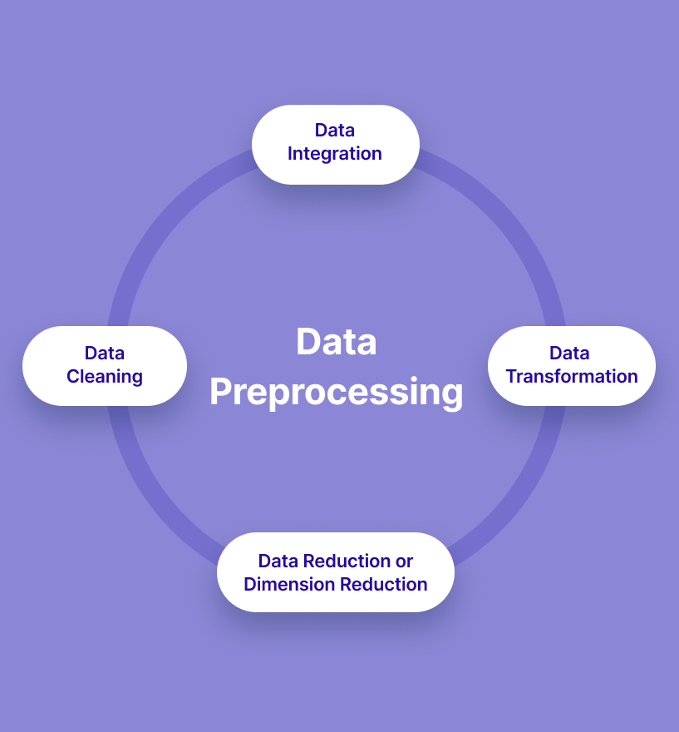
Slide 4: Data Preprocessing
Data Preprocessing Steps
Data Cleaning
Data Integration
Datetime Conversion
Handling Missing Values
Data Transformation
Data reduction or Dimension Reduction
Notes:
Slide 4: Data Preprocessing
Title: Data Preprocessing Steps
Content:
Datetime Conversion: Convert date and time columns to appropriate datetime formats.
Handling Missing Values:
Focus on columns like "Actual Arrival Time" and "Reason for Delay".
Drop or fill missing values depending on their significance.
Categorical Encoding: Encode categorical variables like "Purchase Type" and "Payment Method" for modeling.

Slide 5
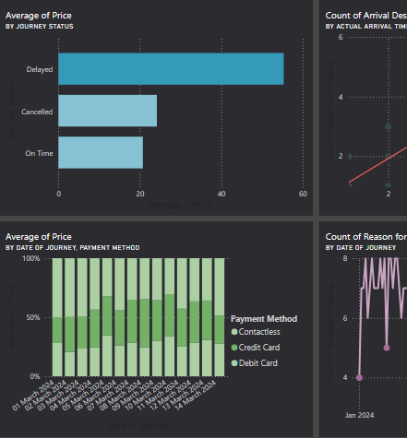
Slide 5: Exploratory Data Analysis
Title: Exploratory Data Analysis
Ticket Price Distribution: Analyze the distribution of ticket prices.
Patterns in Delays: Examine delays by departure station, time of day, ticket class, etc.
Correlation Analysis: Investigate relationships between different variables, such as the correlation between ticket class and delay likelihood.

Slide 6
Slide 6: Feature Engineering
Title: Feature Engineering
Aggregation: Aggregate data by dates to analyze trends over time
Visualizations: Create word clouds for Departure and Arrival stations to identify popular routes

Slide 7
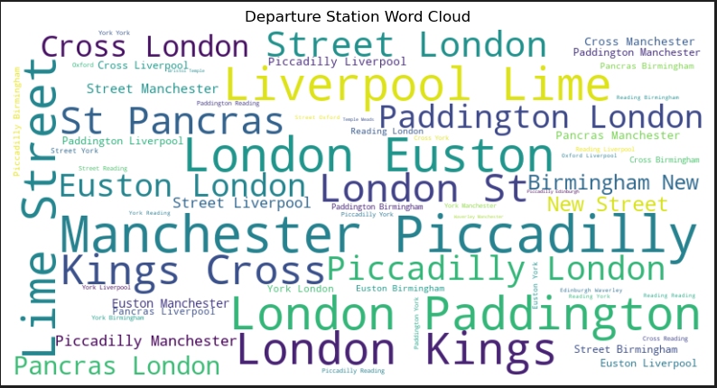

Slide 8
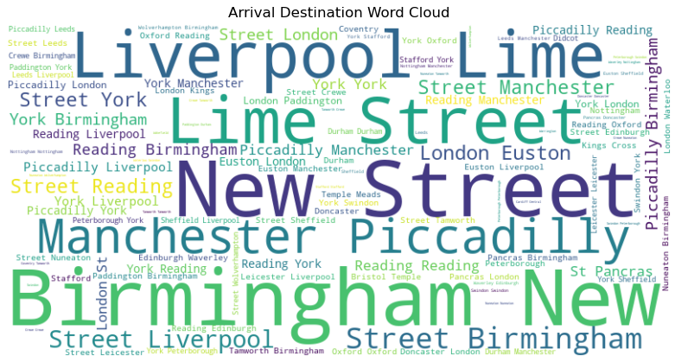

Slide 9

Slide 7: Modeling: Classification
Modeling: Delay Prediction
Model Selection
Training and Testing
Evaluation Metrics
Notes:
Slide 7: Modeling: Classification
Title: Modeling: Delay Prediction
Content:
Model Selection:
Choose models like Random Forest, XGBoost, or Logistic Regression for predicting delays.
Justify the choice of model based on the problem and dataset.
Training and Testing:
Split the data into training and testing sets.
Train the model on the training set and evaluate on the test set.
Evaluation Metrics: Use accuracy, precision, recall, and F1 score to evaluate model performance.

Slide 10
Slide 8: Modeling: Time Series Forecasting
Title: Time Series Forecasting
Objective: Forecast future ticket sales and potential delays
Models Used
Evaluation: Use MAE and RMSE to assess the accuracy of the forecast
Notes:
Slide 8: Modeling: Time Series Forecasting
Title: Time Series Forecasting
Content:
Objective: Forecast future ticket sales and potential delays.
Models Used:
ARIMA, Prophet, or LSTM for time series forecasting.
Steps:
Aggregate ticket sales by date.
Fit the model and forecast future sales for the next four years.
Evaluation: Use MAE and RMSE to assess the accuracy of the forecast.

Slide 11

Slide 9: Model Evaluation
Title: Model Evaluation Metrics
Regression Metrics: Explain Mean Absolute Error (MAE) and Root Mean Squared Error (RMSE) for time series models.
Classification Metrics: Detail accuracy, precision, recall, and F1 score for classification models.
Comparison: Show how different models performed on the test data.
Notes:
Slide 9: Model Evaluation
Title: Evaluating Model Performance
Content:
Overview of Model Evaluation:
Purpose: Assess the effectiveness of the machine learning models to ensure they perform well and generalize effectively to unseen data.
Key Metrics: Metrics for classification and forecasting models to measure performance and accuracy.
Classification Model Evaluation:
Accuracy:
Definition: The proportion of correctly predicted instances out of the total instances.
Formula: Accuracy=Number of Correct Predictions/Total Number of Predictions
Precision, Recall, and F1 Score:
Confusion Matrix:
Definition: A matrix showing the true vs. predicted classifications.
Purpose: Helps visualize performance, showing true positives, false positives, true negatives, and false negatives.
Visualizations:
Confusion Matrix Heatmap: Provide a visual representation of the confusion matrix to easily interpret classification results.
Forecasting Model Evaluation:
Mean Absolute Error (MAE):
Definition: The average of the absolute errors between predicted and actual values.
Root Mean Squared Error (RMSE):
Definition: The square root of the average of squared errors between predicted and actual values.
Visualizations:
Forecast Accuracy Plot: Plot showing the forecasted values against actual values to visualize prediction accuracy.

Slide 12

Slide 10: AI Implementation Strategy
Title: AI Implementation Strategy for Southeastern Railway
Notes:
Slide 10: AI Implementation Strategy for Southeastern Railway
Title: AI Implementation Strategy for Southeastern Railway
Objective: To provide a strategic roadmap for integrating AI technologies to enhance operations, optimize performance, and improve customer satisfaction within the Southeastern Railway.
**1. AI Strategy Overview:
Goals:
Improve operational efficiency.
Enhance customer experience.
Optimize resource allocation.
Reduce operational costs.
**2. AI Use Cases and Solutions:
Predictive Maintenance:
Objective: Minimize downtime and maintenance costs by predicting equipment failures.
Implementation: Use machine learning models to analyze sensor data from trains and infrastructure to predict failures.
Benefit: Reduces unexpected breakdowns and improves safety.
Demand Forecasting:
Objective: Accurately predict passenger demand and ticket sales.
Implementation: Utilize time series forecasting models to anticipate future travel patterns and sales trends.
Benefit: Enhances scheduling, staffing, and resource management.
Dynamic Pricing:
Objective: Optimize ticket pricing based on demand fluctuations and customer behavior.
Implementation: Apply machine learning algorithms to adjust ticket prices dynamically.
Benefit: Maximizes revenue and adjusts prices according to market conditions.
Customer Service Chatbots:
Objective: Provide 24/7 customer support and handle common queries.
Implementation: Deploy AI-driven chatbots for real-time assistance and support.
Benefit: Improves customer service efficiency and satisfaction.
Journey Optimization:
Objective: Optimize route planning and reduce travel times.
Implementation: Use AI to analyze historical journey data and optimize schedules and routes.
Benefit: Enhances operational efficiency and reduces delays.
**3. Implementation Steps:
Phase 1: Pilot Projects
Selection: Choose specific use cases for initial implementation (e.g., predictive maintenance, demand forecasting).
Execution: Run pilot projects to test feasibility and refine models.
Evaluation: Assess pilot outcomes and gather feedback.
Phase 2: Scaling Up
Integration: Expand successful pilot projects to broader operations.
Training: Train staff and integrate AI tools into existing systems.
Monitoring: Continuously monitor performance and make necessary adjustments.
Phase 3: Full Deployment
Expansion: Roll out AI solutions across all relevant areas of the organization.
Optimization: Regularly update models and systems based on new data and insights.
Evaluation: Conduct comprehensive evaluations to measure impact and ROI.
**4. Key Success Factors:
Data Quality: Ensure high-quality, clean data for accurate AI model performance.
Change Management: Manage organizational change and train employees to work with AI tools.
Stakeholder Engagement: Involve key stakeholders in the planning and implementation process.
Continuous Improvement: Regularly review and update AI strategies to align with evolving needs and technologies.
**5. Challenges and Mitigation:
Data Privacy: Implement robust data protection measures to ensure compliance with regulations.
Integration Complexity: Develop a detailed integration plan to address technical and operational challenges.
Cost: Conduct a cost-benefit analysis to justify AI investments and ensure alignment with budget constraints.
**6. Conclusion:
Summary: Recap the strategic benefits of AI for the Southeastern Railway.
Call to Action: Encourage the initiation of pilot projects and continued investment in AI technologies.

Slide 13

Slide 11: Challenges and Considerations
Title: Challenges and Considerations
Content:
Data Challenges:
Issues with data quality, completeness, and consistency.
Model Challenges:
Overfitting, interpretability, and generalization to new data.
Ethical Considerations:
Data privacy, algorithmic bias, and transparency.
Stakeholder Buy-In:
Importance of getting support from key stakeholders for AI adoption.
Notes:
Slide 11: Challenges and Considerations
Title: Challenges and Considerations in Implementing AI for Southeastern Railway
Objective: To identify and address the key challenges and considerations associated with implementing AI technologies within the Southeastern Railway, and to propose strategies for overcoming these hurdles.
**1. Data Quality and Availability:
Challenge: AI models rely on high-quality, accurate, and comprehensive data. Incomplete or inconsistent data can lead to unreliable predictions and insights.
Consideration: Ensure robust data collection processes and invest in data cleaning and preprocessing. Implement regular data audits and validation procedures.
**2. Integration with Legacy Systems:
Challenge: Integrating AI solutions with existing legacy systems can be complex and may require significant modifications.
Consideration: Develop a clear integration strategy that includes compatibility checks and incremental implementation. Consider using middleware or APIs to bridge gaps between new AI systems and legacy infrastructure.
**3. Cost and Resource Allocation:
Challenge: The initial cost of implementing AI technologies can be high, including expenses for technology, training, and infrastructure.
Consideration: Perform a thorough cost-benefit analysis to justify the investment. Explore phased implementation and funding options, and consider leveraging grants or partnerships.
**4. Change Management:
Challenge: AI implementation can face resistance from employees and stakeholders who are accustomed to existing processes.
Consideration: Develop a comprehensive change management plan that includes training, communication, and support. Engage employees early in the process and address their concerns proactively.
**5. Skill Gaps and Training:
Challenge: AI technologies require specialized skills that may not be readily available within the existing workforce.
Consideration: Invest in training programs to upskill current employees and consider hiring or consulting with AI experts. Foster a culture of continuous learning and development.
**6. Ethical and Regulatory Compliance:
Challenge: Ensuring that AI systems comply with ethical standards and regulatory requirements is critical to avoid legal issues and maintain public trust.
Consideration: Stay informed about relevant regulations and ethical guidelines. Implement robust governance frameworks and conduct regular audits to ensure compliance.
**7. Data Privacy and Security:
Challenge: Handling sensitive data, such as passenger information, requires stringent security measures to prevent breaches and misuse.
Consideration: Implement strong data security protocols, including encryption and access controls. Ensure compliance with data protection regulations such as GDPR or CCPA.
**8. Model Accuracy and Reliability:
Challenge: AI models need to be accurate and reliable to deliver value. Inaccurate models can lead to poor decision-making and operational issues.
Consideration: Regularly evaluate and update AI models using new data and performance metrics. Implement validation techniques and continuous monitoring to ensure model reliability.
**9. Scalability and Flexibility:
Challenge: AI solutions must be scalable to handle increasing data volumes and adaptable to evolving needs.
Consideration: Design AI systems with scalability in mind and ensure they can be easily adapted to new use cases or changes in the business environment.
**10. Performance Monitoring and Evaluation:
Challenge: Continuous monitoring and evaluation of AI performance are essential for ensuring long-term success.
Consideration: Establish performance metrics and monitoring tools to track AI system effectiveness. Use feedback loops to make iterative improvements based on performance data.
**11. Vendor Management:
Challenge: Choosing and managing vendors for AI technology and services can be challenging.
Consideration: Conduct thorough vendor evaluations and establish clear contracts and service level agreements (SLAs). Maintain regular communication and performance reviews with vendors.
**12. Customer Acceptance:
Challenge: Ensuring that customers accept and trust AI-driven services can be a barrier to successful implementation.
Consideration: Communicate the benefits of AI technologies to customers and provide transparent information about how their data is used. Implement user-friendly interfaces and provide support for any issues.
Notes for Presentation:
Visuals and Graphics:
Use diagrams or flowcharts to illustrate integration processes and change management strategies.
Include bullet points or tables to summarize challenges and considerations for clarity.
Examples:
Provide real-world examples of challenges faced by other organizations in implementing AI and how they were addressed.
Q&A:
Be prepared to discuss specific challenges related to the Southeastern Railway’s context and how the proposed strategies can be tailored to address them.

Slide 14

Slide 12: Conclusion
Summary: Recap how AI can be utilized to enhance Southeastern Railway’s operations
Call to Action: Encourage stakeholders to explore AI opportunities in the railway industry
Notes:
Slide 12: Conclusion
Title: Conclusion and Call to Action
Objective: To summarize the key takeaways from the presentation, reaffirm the benefits of AI integration for Southeastern Railway, and outline the immediate next steps and call to action for stakeholders.
**1. Summary of Key Points:
AI Potential: Artificial Intelligence offers transformative potential for Southeastern Railway, including improved operational efficiency, enhanced customer experience, and innovative solutions for future growth.
Strategic Implementation: A structured approach involving phased implementation, continuous monitoring, and adaptation is crucial for successful AI integration.
Challenges and Considerations: Addressing challenges such as data quality, integration complexity, and regulatory compliance is essential for effective AI deployment.
Future Outlook: Embracing AI as part of the long-term vision will drive operational excellence, foster innovation, and ensure Southeastern Railway remains competitive in the evolving transportation landscape.
**2. Benefits of AI Integration:
Enhanced Efficiency: Streamlined operations, optimized resource allocation, and reduced operational costs.
Improved Customer Experience: Personalized services, real-time updates, and increased satisfaction.
Innovative Capabilities: New technological solutions, predictive maintenance, and advanced safety measures.
**3. Next Steps:
Initiate Pilot Projects: Begin with pilot projects to test and refine AI applications.
Build Data Infrastructure: Enhance data collection and management practices to support AI initiatives.
Employee Training: Invest in training programs to develop AI skills and knowledge within the organization.
Engage Stakeholders: Involve employees, customers, and partners in the AI implementation process to ensure alignment and support.
**4. Call to Action:
Leadership Commitment: Secure commitment from leadership to support and drive AI initiatives.
Cross-Functional Collaboration: Foster collaboration across departments to ensure successful AI integration and maximize benefits.
Continuous Evaluation: Implement mechanisms for ongoing evaluation and improvement of AI solutions.
Feedback Integration: Encourage feedback from stakeholders to refine AI strategies and address any challenges.
**5. Final Thoughts:
AI as a Strategic Asset: Emphasize that AI is not just a technological upgrade but a strategic asset that can significantly enhance Southeastern Railway’s operations and customer service.
Long-Term Vision: Reinforce the importance of aligning AI initiatives with the long-term vision of the organization to drive sustainable growth and innovation.

Slide 15

Slide 13: Q&A
Title: Questions & Answers
Notes:
Slide 13: Q&A and Discussion
Title: Questions & Answers
Objective: To open the floor for questions from the audience, clarify any points discussed in the presentation, and engage in a constructive discussion about the AI implementation strategy for Southeastern Railway.
**1. Encourage Questions:
Invitation to Ask: Invite the audience to ask any questions they have regarding the AI implementation strategy, specific details from the presentation, or related topics.
Topics for Discussion: Encourage questions on areas such as:
The practical aspects of AI integration
Specific AI technologies and tools mentioned
Data management and quality assurance
Expected outcomes and ROI
Challenges and how they will be addressed
**2. Facilitate Discussion:
Interactive Dialogue: Foster an interactive dialogue where participants can share their thoughts, concerns, or insights about the AI strategy.
Clarify Doubts: Address any uncertainties or misconceptions about the AI implementation process and its impact.
Feedback: Collect feedback on the proposed strategy and discuss any additional suggestions or improvements.
**3. Action Points:
Summarize Key Takeaways: Summarize the key takeaways from the discussion and any actionable items that arise.
Follow-Up: Highlight any follow-up actions or next steps based on the questions and feedback received.
**4. Contact Information:
Provide Contacts: Share contact information for further questions or continued discussion. Include details such as:
Email addresses
Phone numbers
Relevant team members or departments to reach out to
**5. Visuals and Graphics:
Q&A Icon: Use a Q&A icon or graphic to signify the start of the question and answer session.
Discussion Points: Optionally, display key discussion points or topics on the slide to guide the conversation.
**6. Wrap-Up:
Thank the Audience: Thank the audience for their participation and engagement.
Reiterate Importance: Reiterate the importance of collaboration and feedback in the successful implementation of AI at Southeastern Railway.
Final Note: This slide provides an opportunity for interactive engagement with the audience, allowing for a deeper understanding of the AI strategy and addressing any remaining questions or concerns. It helps ensure that stakeholders are fully informed and supportive of the proposed AI initiatives.

Slide 16
Slide 14: References
Artificial Intelligence in Transportation Information for Application. (2007). https://onlinepubs.trb.org/onlinepubs/circulars/ec113.pdf
Aslam, M. (2024). National Rail UK Train Ticket Data. Kaggle.com. https://www.kaggle.com/datasets/motsimaslam/national-rail-uk-train-ticket-data
ISO. (2022). ISO/IEC 27001 standard – information security management systems. ISO. https://www.iso.org/standard/27001
NIST, G. M. (2024). Artificial Intelligence Risk Management Framework: Generative Artificial Intelligence Profile. Artificial Intelligence Risk Management Framework: Generative Artificial Intelligence Profile, NIST AI 600-1(NIST AI 600-1 2024). https://doi.org/10.6028/nist.ai.600-1
Provost, F., & Fawcett, T. (2013, August 20). Data Science for Business [Book]. Www.oreilly.com. https://www.oreilly.com/library/view/data-science-for/9781449374273/
Quick Start. (2017). Prophet. https://facebook.github.io/prophet/docs/quick_start.html

Slide 17
References (Cont'd)
7. Scikit-learn. (2019). scikit-learn: machine learning in Python — scikit-learn 0.20.3 documentation.
Scikit-Learn.org. https://scikit-learn.org/stable/index.html
8. Seaborn. (2012). seaborn: statistical data visualization — seaborn 0.9.0 documentation. Pydata.org. https://seaborn.pydata.org/
9. Tang, R., De Donato, L., Bes̆inovićN., Flammini, F., Goverde, R. M. P., Lin, Z., Liu, R., Tang, T., Vittorini, V., & Wang, Z. (2022). A literature review of Artificial Intelligence applications in railway systems. Transportation Research Part C: Emerging Technologies, 140(103679), 103679. https://doi.org/10.1016/j.trc.2022.103679
10. With, L. (2019). Hands-On Machine Learning with Scikit-Learn, Keras, and TensorFlow, 2nd Edition. O’Reilly Online Learning. https://www.oreilly.com/library/view/hands-on-machine/9781492032632/
11. Yu, R., Lu, J., Zhao, Z., Han, J., & Bai, L. (2019). Research on CMT Welding Temperature Field Detection Technology Based on Color CCD. 2019 3rd International Conference on Electronic Information Technology and Computer Engineering (EITCE). https://doi.org/10.1109/eitce47263.2019.9094932

